Slide 1

Listening to the Weather: Modelling for a Weather-Based Spotify Playlist
Project #4: Capstone
Eli Ordonez
DAB05

Slide 2

Q: Music streaming in Japan is more competitive and crowded than ever. How can Spotify maintain competitive advantage?
A: What if we carved out a localised niche?

Slide 3

Persona #1: Taro-san
Here he is!
Rainy days: Warm, cozy music
Sunny days: upbeat and energetic music
Doesn’t want to keep making new playlists to hear what he wants when he wants when the weather is right
Here he is!
Persona #2: Kenzo-san
Only cares about novelty
Excited about any personalised or dynamic features on Spotify

Slide 4

Problem Statement
This project aims to boost Spotify’s user engagement and sales through the development of a model that can curate a dynamic playlist based on the day’s weather conditions.

Slide 5

Summary of the Data

Slide 6
“Top Spotify Songs in 73 Countries” (Kaggle¹)
Datasets Used
Documents the daily top 50 songs on Spotify in different countries between October 2023 and April 2025
Provides columns rating a song’s characteristics between 0 and 1
“Daily Historical Japan Weather (Tokyo)” (Open-Meteo²)
Compiles daily summaries of Tokyo’s weather from the same time period.
¹https://www.kaggle.com/datasets/asaniczka/top-spotify-songs-in-73-countries-daily-updated
²https://open-meteo.com/

Slide 7

Limitations
Region-specific Spotify data was unavailable
Why use Tokyo’s weather data? It was the city with the highest rate of Spotify users¹ – most likely to reflect Spotify trends country-wide.
Hourly or minute-by-minute Spotify data was unavailable
Unable to track real-time changes in music listening
Data for other Spotify playlists were unavailable
Music data limited to 50 songs per day
Unable to track whether people will listen outside the Top 50 when weather changes
¹https://www.start.io/audience/spotify-music-users-in-japan?utm_source

Slide 8
Data Cleaning
For both datasets:
Duplicates were identified and removed
No null values
Inaccurate data types corrected (e.g. date-related columns)

Slide 9
Building the Model

Slide 10
Q: Will the model recommend me a specific song to listen to under specific weather?
No.
People don’t listen to a specific song only under specific weather conditions.
Q: So, what are we modelling?
How listening patterns change might be reflected in the mix of genres people listen to per day.
Aim: Predict the proportions of different genres listened to on a given day, based on that day’s weather conditions.

Slide 11
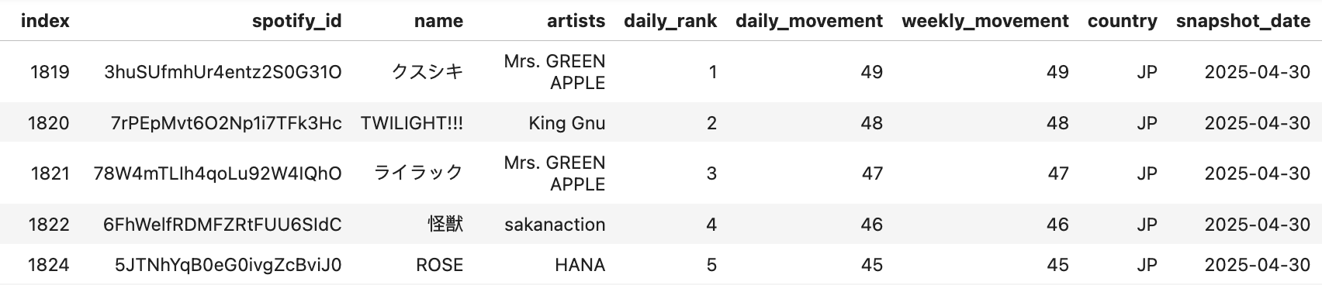

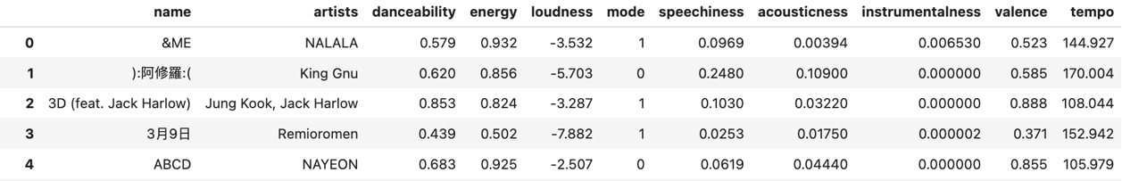
Handling Spotify Data
50 songs per day
247 Distinct songs from dataset extracted
Songs are clustered purely on their musical characteristics

Slide 12
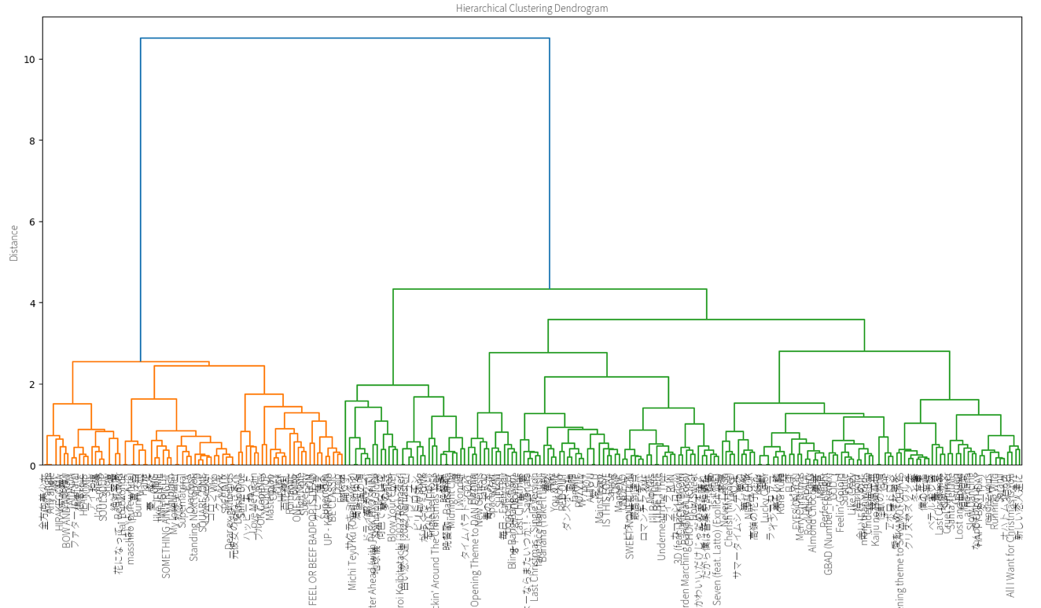
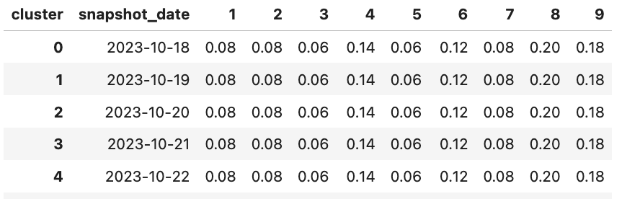
Handling Spotify Data
9 clusters determined = 9 different genres
Every distinct song assigned to a cluster
After joining cluster numbers to main Spotify dataset...
Main Spotify Dataset: Group by date & cluster
Cluster data = Y (to predict)
Weather data to be joined = X

Slide 13
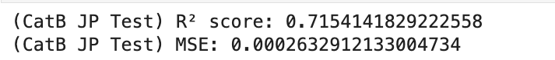
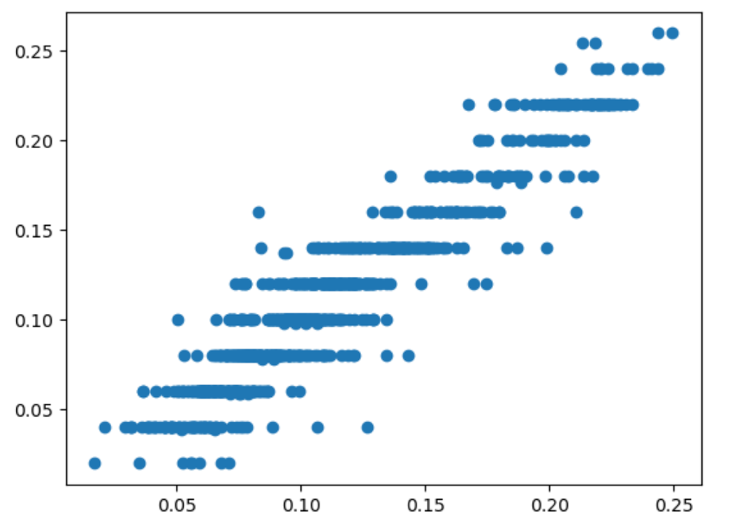
CatBoost Regression
Test Data Results
How it works: Similar to XGBoost but pays closer attention to complex relationships between variables.
R² score of 0.72 is not very accurate, but was my best model
Suggests that the correlation between music listening patterns and weather is not very strong.
The ”error” not explained the model could be a result of predicting purely based on weather

Slide 14
5 Seconds of Summer?

Slide 15

Guess which season this playlist belongs to!
These songs were from
Winter
Song #1: Inferno Love Letter – tuki.
Song #2: Michi Teyu Ku – Fujii Kaze
Song #3: XG – Something Ain’t Right
Scan to listen to the whole playlist

Slide 16

How about this playlist?
These songs were from
Summer
Song #1: Dance Hall by Mrs. GREEN APPLE
Song #2: UP by KARINA (aespa)
Song #3: Chk Chk Boom by Stray Kids
Scan to listen to the whole playlist

Slide 17
Conclusions & Recommendations

Slide 18

Weather is not the best predictor of the most popular music in Japan on a given day
Realistically, the makeup of the Top 50 is determined by a variety of factors, including
The amount of promotion a song is receiving from the record label that produced it
The song’s existing popularity

Slide 19
Is a weather-based playlist still possible?
Absolutely. With some help!
Gather minute-by-minute listening data
Real changes in listening patterns based on weather can be tracked
Track how listenership of other mood-based playlists (e.g Lofi Beats) change based on weather
Curation can be conducted with more supervision
Curation is a complex issue
Spotify’s curators can decide on which songs to pair with different weather conditions

Slide 20
Take this project as a proof of concept.
Think about what can be achieved with more input!

Slide 21

Thank You!

Slide 22
Appendix

Slide 23
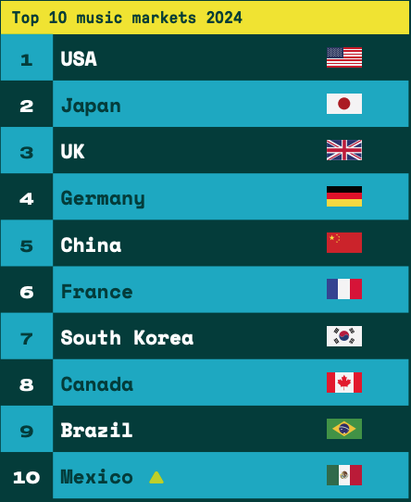
As of 2024, Japan’s Music Industry has been doing well...¹
As of 2022, music streaming contributed 88.4% of digital music revenue.²
Localisation as a recent trend
LINE Music: Fuses J-pop-focused curation with LINE’s popular messaging app
¹International Federation of the Phonographic Industry, State of the Industry 2025 Report
²Recording Industry Association of Japan, Year Book 2023

Slide 24



Taro-san Exists!
... music features reflecting high intensity and positive emotions were positively associated with daily temperatures and negatively associated with rainfall...
Anglada-Tort, M., Lee, H., Krause, A. E., & North, A. C. (2023). Here comes the sun: Music features of popular songs reflect prevailing weather conditions. Royal Society Open Science, 10(5). https://doi.org/10.1098/rsos.221443

Slide 25
Data Cleaning
Spotify Dataset
Japan data was isolated to form the base music dataset
3 duplicates were identified and removed(same song & artist under different song title)
No null values
Inaccurate data types corrected
Weather Dataset
No null values or duplicate values/rows
Time-related columns converted to datetime

Slide 26
Exploratory Data Analysis (Weather)

Slide 27
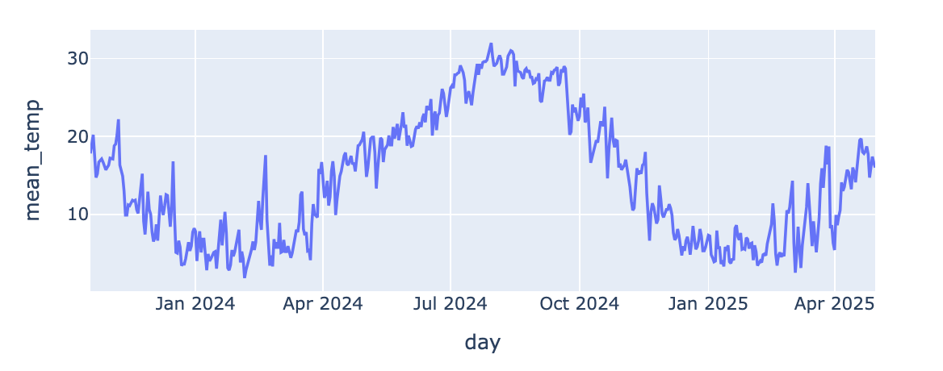
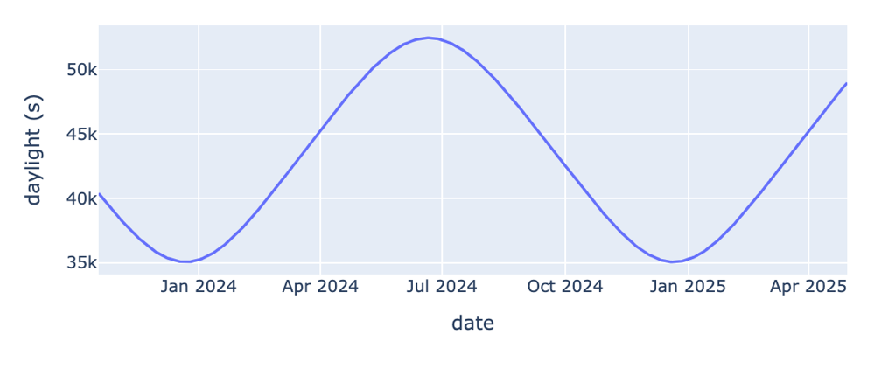
Exploratory Data Analysis
Mean temperature and daylight duration both demonstrated consistent patterns throughout the year:
Highest between July and August (Summer)
Lowest between December and January (Winter)
Mean temperature in Tokyo
Daylight duration in Tokyo

Slide 28
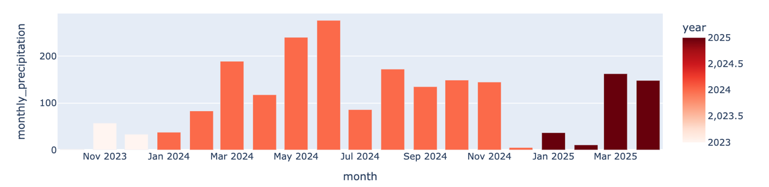
Exploratory Data Analysis
Precipitation: A general pattern was most obvious when viewed from a monthly basis
Highest between May and June
Lowest between January and February
Monthly precipitation in Tokyo

Slide 29
Exploratory Data Analysis
Later, we can try focusing on the following measures to optimise our model:
Temperature
Sunlight Duration
Precipitation

Slide 30
Preparations for Modelling

Slide 31
Handling Spotify Data
Original Dataset: 50 Songs per date (“snapshot_date”)
27,052 rows, 26 columns
Prepare to Cluster: Distinct songs from dataset extracted
247 rows → Indicates only 247 distinct songs
Songs are clustered purely on their musical characteristics

Slide 32
Notes on Japanese Spotify Data
What does it mean for Japan to only have 247 distinct songs across 541 days' worth of Top 50 lists?
Relative cultural homogeneity (e.g Japanese as the main spoken language)
Domestic music is generally smaller in quantity than the collective output of the rest of the world
Japan already has a healthy domestic music industry... Music from the West would naturally have a smaller market share.

Slide 33
Handling Spotify Data
Distinct songs sent for hierarchical clustering
Cluster tree cut off at distance = 2
9 clusters = different music genres/styles
Every distinct song assigned to a cluster
After joining cluster numbers to main Spotify dataset...
Main Spotify Dataset: Group by date & cluster
Result = Percentage of songs belonging to each cluster in each date’s Top 50 list
1 Row per date now
Ready to be joined with weather data

Slide 34
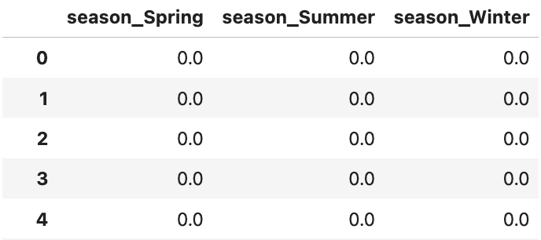
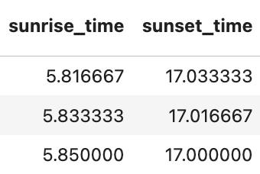
Merging Song Cluster Data & Weather Data
Seasonality added as a column to the combined dataset, then one-hot encoded.
Sunlight/Sunset timings converted to float format
FINAL DATASET SHAPE: 541 rows, 28 columns
Remember: There were only 541 days captured in the Spotify Japan data

Slide 35
Modelling

Slide 36
Y and X Variables
Y Variables
Proportions for 9x Clusters
X Variables
All columns pertaining to
Temperature
Precipitation
Relative Humidity
Wind Speed
Sunlight Duration
Sunlight/Sunset Timings
Seasonality

Slide 37
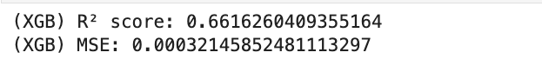
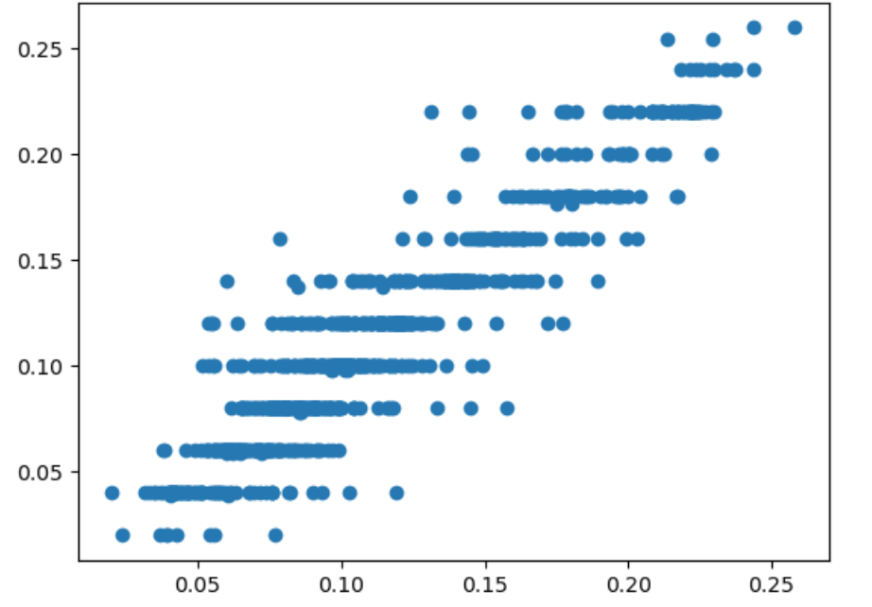
XGBoost Regression
Test Data Results
Achieved an R² score of 0.99 using train data
Only achieved an R² score of 0.66 using test data
Suggests that the correlation between music listening patterns and weather is not very strong.

Slide 38
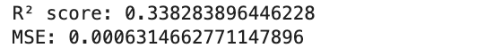
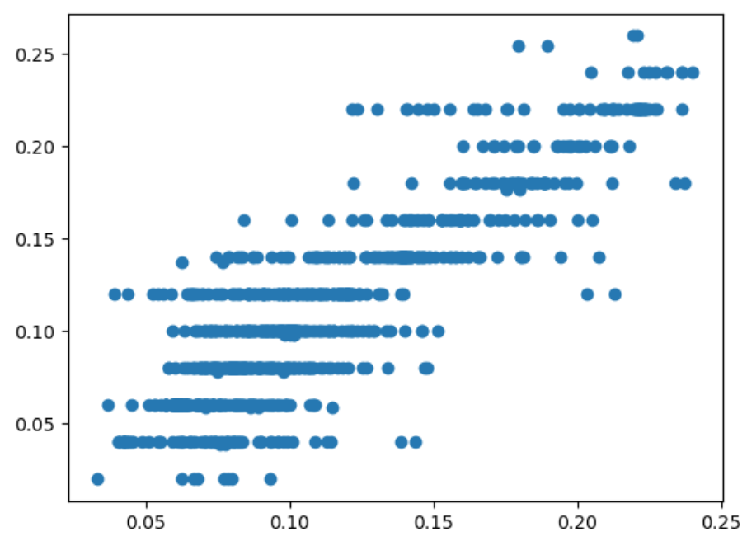
“Optimising” Our X Variables
Test Data Results
Ran only the following weather measures through XGBoost:
Temperature
Daylight Duration
Precipitation
Achieved a poorer R² score of 0.34 using test data
Suggests that taking all weather variables into consideration makes a better model.

Slide 39
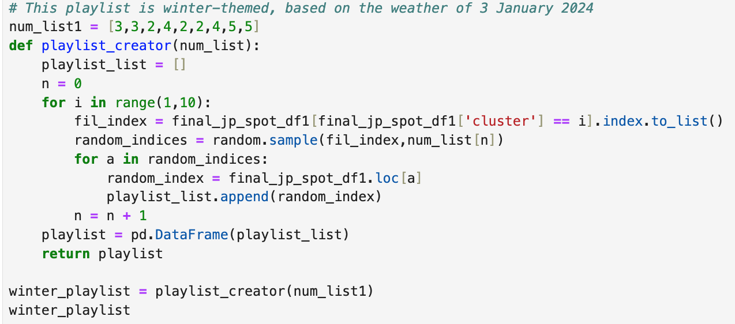
Making Demo Playlists
I put the numbers from the dashboard into a function I defined
It randomly chooses the appropriate number of songs from each cluster

Slide 40
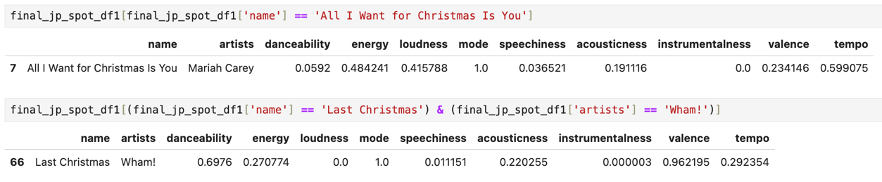
Limitations: Part 2
The musical characteristic scores under some songs seem quite questionable.
Mariah Carey’s “All I Want for Christmas Is You”
Low valence of 0.336 despite its upbeat and joyous nature
Wham!’s “Last Christmas”
High valence of 0.962 despite its moodier tone and sadder subject matter.

